Slide 1

Mapping Inputs to Outputs: Data Representation
Professor Bo Liu
James Watt School of Engineering

Slide 2
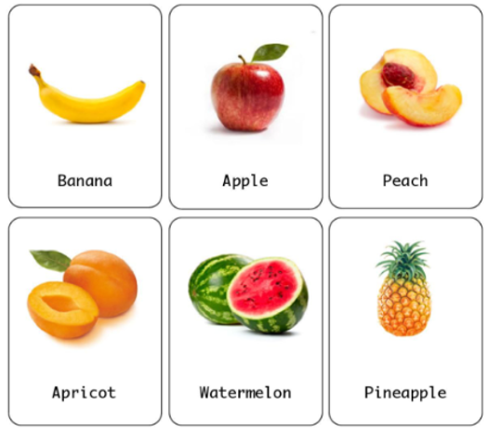

Machine learning procedure
ML model development
Represent data: the data should be translated to the language that ML algorithms can understand → Data encoding
Select ML algorithms: Using parametric or non-parametric ML?
Evaluate output: prediction errors
Data representation
Select ML algorithms
Model training
Model evaluation
Application
Prediction
Apple
Not Apple
Input
Trained model
Output

Slide 3
Data types and encoding
Represent data: the data should be translated to the language that ML algorithms can understand → Data encoding
Select ML algorithms: Using parametric or non-parametric ML?
Evaluate output: prediction errors
Data representation
Select ML algorithms
Model training
Model evaluation

Slide 4
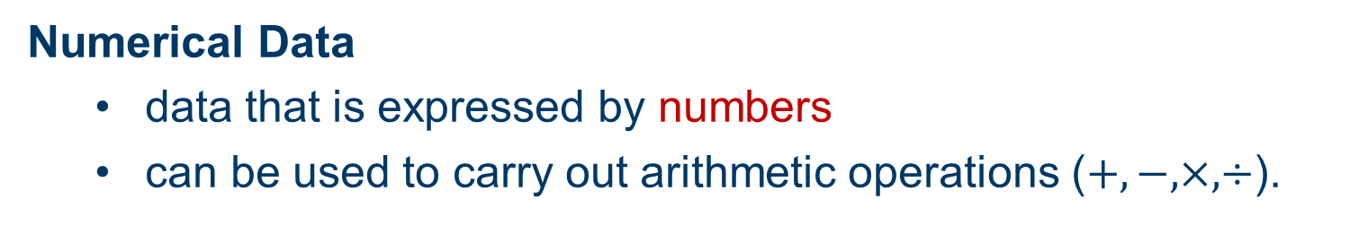
Data types in ML
Numerical Data
  data that is expressed by numbers
  can be used to carry out arithmetic operations ($+, −, ×,÷$).
Types of Numerical Data
Continuous data: any data values in a particular range, e.g., height (177.4 mm), velocity (18.44 m/s)
Discrete data: data with countable fixed elements, sometimes represented by integers, e.g., age (age of 25, 89), number of students (30, 40 students)

Slide 5
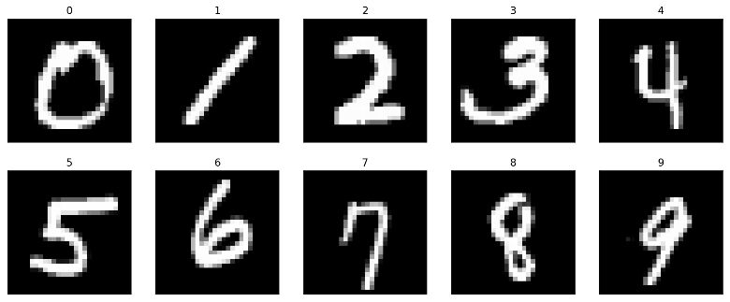
More on discrete data
Number of students =20
Handwritten digits recognition
Numerical
Categorical

Slide 6
Data types in ML
Categorical Data
  stored into groups or categories
  represented by names or labels
Types of Categorical Data
Binary data: true, false. Usually encoded with 0, 1.
Nominal data: also called naming data, e.g., name of a person (Julia, Jack, … )
Ordinal data: data includes elements that are ranked, ordered or have a rating scale attached
  e.g., the rating of a restaurant’s menu (strongly dislike, dislike, neutral, like, strongly like)

Slide 7
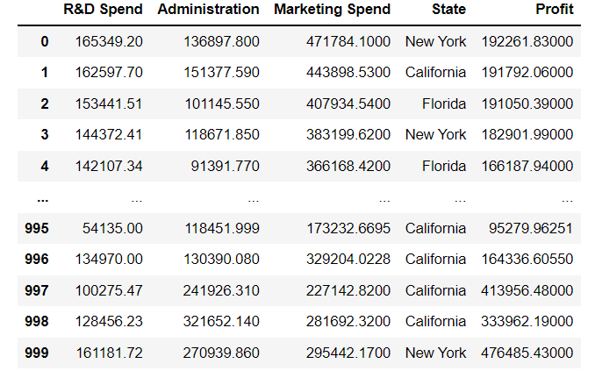
Data types in ML
Numerical data
Categorial data
Q: How to represent (or encoding) categorical data?

Slide 8
Encoding of ordinal data
Ordinal encoding
Each unique ordinal data is assigned an integer value.
Often, integer values starting at zero are used.
Ordinal data
Encoded data
strongly dislike
dislike
neutral
like
strongly like
0
1
2
3
4
ordinal encoding

Slide 9
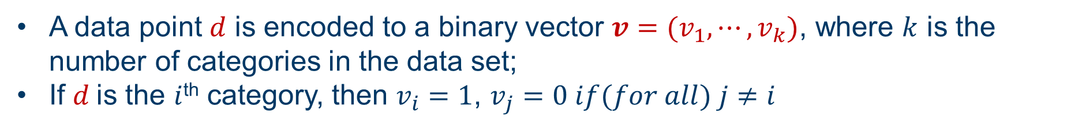
Encoding of nominal data
One hot encoding
A data point $d$ is encoded to a binary vector $v=(v_{1}, ⋯, v_{k})$, where $k$ is the number of categories in the data set;
If $d$is the $i$^{th} category, then $v_{i}=1$, $v_{j}=0 if(for all) j≠i$
Example: encode a color set with three categories {red, green, blue}.
Color
d1 | d2 | d3
1 | 0 | 0
0 | 1 | 0
0 | 0 | 1
Red
One hot encoding
Green
Blue

Slide 10
Encoding of nominal data
Dummy encoding
Dummy encoding uses $k−1$ binary variables, rather than k binary variables.
For the color set with three categories: {red, green, blue}.
Three binary variables is required to encoding these category variables.
Color
d1 | d2
1 | 0
0 | 1
0 | 0
Red
dummy encoding
Green
Blue

Slide 11
Encoding of nominal data
One hot encoding vs. dummy encoding
Categorical data set: {New York, California, Florida, Washington}
One hot encoding
Dummy encoding
New York: [1 0 0 0]
California: [0 1 0 0]
Florida: [0 0 1 0]
Washington: [0 0 0 1]
New York: [1 0 0]
California: [0 1 0]
Florida: [0 0 1]
Washington: [0 0 0]

Slide 12




Thanks!
#UofGWorldChangers
@UofGlasgow

